Slide 1
COMP 3500 Introduction to Operating Systems File Management
Dr. Xiao Qin
Auburn University http://www.eng.auburn.edu/~xqin
xqin@auburn.edu
Slides are adopted and modified from materials developed by Drs. Stallings and Nutt
Notes:
25 Minutes. Lec16b-Project 5 Put It All Together.pdf
10 Minutes. Review LRU
15 Minutes. Slides 1-12.

Slide 2
The External View of the File Manager
Application
Program
mount()
write()
CreateFile()
WriteFile()
close()
open()
CloseHandle()
ReadFile()
lseek()
read()
SetFilePointer()
File Mgr
Device Mgr
Memory Mgr
File Mgr
Device Mgr
Process Mgr
Memory Mgr
Process Mgr
UNIX
Windows
Hardware

Slide 3
File Management
File is a named, ordered collection of information
Q1: What are a file manager’s responsibilities?
Storing the information on a device
Mapping the block storage to a logical view
Allocating/deallocating storage
Providing file directories
Notes:
What abstraction should be presented to programmer?

Slide 4
Structure Terms
Four terms are commonly used when discussing files:
Field
Record
File
Database
Notes:
Four terms are in common use when discussing files:
• Field
• Record
• File
• Database
A field is the basic element of data. An individual field contains a single value,
such as an employee’s last name, a date, or the value of a sensor reading. It is characterized
by its length and data type (e.g., ASCII string, decimal). Depending on the
file design, fields may be fixed length or variable length. In the latter case, the field
often consists of two or three subfields: the actual value to be stored, the name of
the field, and, in some cases, the length of the field. In other cases of variable-length
fields, the length of the field is indicated by the use of special demarcation symbols
between fields.
A record is a collection of related fields that can be treated as a unit by some
application program. For example, an employee record would contain such fields
as name, social security number, job classification, date of hire, and so on. Again,
depending on design, records may be of fixed length or variable length. A record
will be of variable length if some of its fields are of variable length or if the number
of fields may vary. In the latter case, each field is usually accompanied by a field
name. In either case, the entire record usually includes a length field.
A file is a collection of similar records. The file is treated as a single entity by
users and applications and may be referenced by name. Files have file names and
may be created and deleted. Access control restrictions usually apply at the file
level. That is, in a shared system, users and programs are granted or denied access
to entire files. In some more sophisticated systems, such controls are enforced at the
record or even the field level.
Some file systems are structured only in terms of fields, not records. In that
case, a file is a collection of fields.
A database is a collection of related data. The essential aspects of a database
are that the relationships that exist among elements of data are explicit and that the
database is designed for use by a number of different applications. A database may
contain all of the information related to an organization or project, such as a business
or a scientific study. The database itself consists of one or more types of files. Usually,
there is a separate database management system that is independent of the operating
system, although that system may make use of some file management programs.

Slide 5
Information Structure
Applications
Records
Structured Record Files
Record-Stream Translation
Byte Stream Files
Stream-Block Translation
Storage device
Notes:
From the user’s point of view, one of the most important parts of an operating
system is the file system. The file system provides the resource abstractions typically
associated with secondary storage. The file system permits users to create data
collections, called files, with desirable properties, such as:
• Long-term existence: Files are stored on disk or other secondary storage and
do not disappear when a user logs off.
• Sharable between processes: Files have names and can have associated access
permissions that permit controlled sharing.
• Structure: Depending on the file system, a file can have an internal structure
that is convenient for particular applications. In addition, files can be organized
into hierarchical or more complex structure to reflect the relationships
among files.

Slide 6
Q2: Can you design the following byte stream file interface?
fileID = open(fileName)
close(fileID)
read(fileID, buffer, length)
write(fileID, buffer, length)
seek(fileID, filePosition)

Slide 7
Low Level Files
fid = open(“fileName”,…);
…
read(fid, buf, buflen);
…
close(fid);
...
...
b₀
b₁
b₂
b_{i}
int open(…) {…}
int close(…) {…}
int read(…) {…}
int write(…) {…}
int seek(…) {…}
Stream-Block Translation
Storage device response to commands

Slide 8
Structured Files
Records
Record-Block Translation

Slide 9
Record-Oriented Sequential Files
Logical Record
fileID = open(fileName)
close(fileID)
getRecord(fileID, record)
putRecord(fileID, record)
seek(fileID, position)

Slide 10
File Operations
File is an abstract data type
Create
Write
Read
Reposition within file
Delete
Truncate
Open(F_{i}) – search the directory structure on disk for entry F_{i}, and move the content of entry to memory
Close (F_{i}) – move the content of entry F_{i} in memory to directory structure on disk
Notes:
Ask a question.

Slide 11
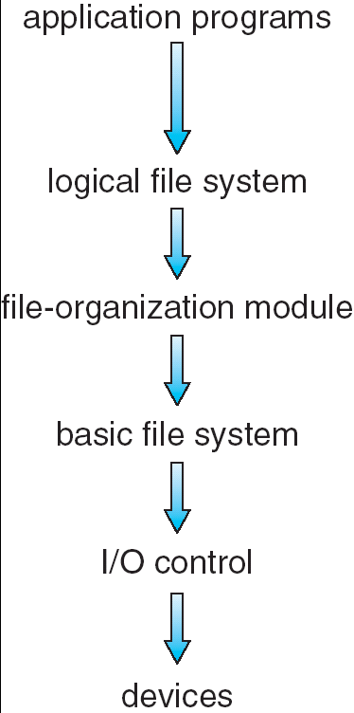
Implementing Low Level Files
Q3: Secondary storage device contains ?
Volume directory (sometimes a root directory for a file system)
External file descriptor for each file
The file contents
Manages blocks
Assigns blocks to files (descriptor keeps track)
Keeps track of available blocks
Maps to/from byte stream
Notes:
Give an example of my senior design project. Real-time disk scheduling.
Illustrate why file systems must be organized into layers

Slide 12
File Descriptors
External name
Current state
Sharable
Owner
User
Locks
Protection settings
Length
Time of creation
Time of last modification
Time of last access
Reference count
Storage device details
How to design a file control block (a.k.a., file descriptor)?
From “File Systems Requirements” to “File Attributes”
From “File Attributes” to “a File Control Block”
Notes:
Reference: http://pages.cs.wisc.edu/~bart/537/lecturenotes/figures/demos-fs.gif

Slide 13
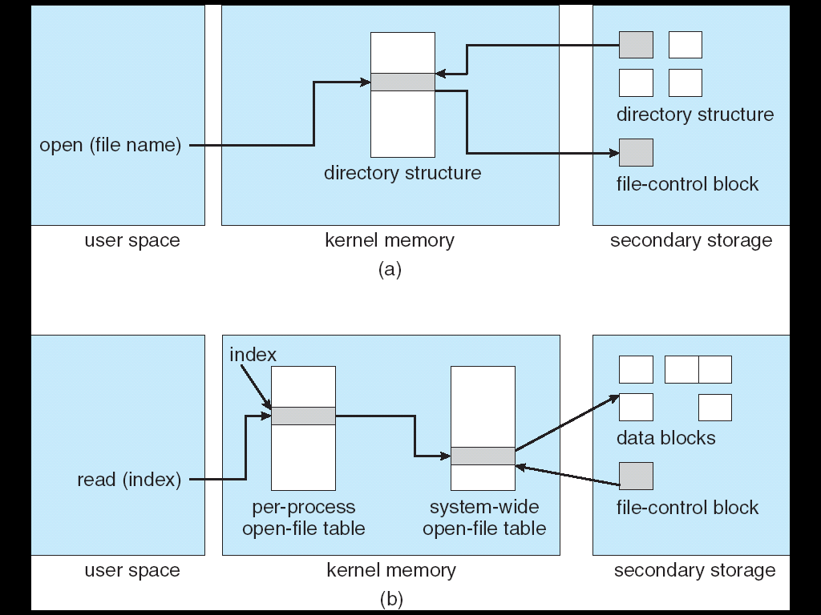
In-Memory File System Structures

Slide 14
An open() Operation
Locate the on-device (external) file descriptor
Extract info needed to read/write file
Authenticate that process can access the file
Create an internal file descriptor in primary memory (“System-wide”)
Create an entry in a “per process” open file status table
Allocate resources, e.g., buffers, to support file usage

Slide 15
File Manager Data Structures
2
Keep the state of the process-file session
1
Copy info from external to the open file descriptor
Open File
Descriptor
3
Return a reference to the data structure
Process-File
Session
External File Descriptor

Slide 16
Summary
Low Level Files
File Descriptors
In-Memory File System Structures
An open() Operation

